Slide 1
Lesson - 3
Layout, Activity and Basic Components

Slide 2
Agenda
Activity Life Cycle
Basic UI Controls
Layouts
Linear Layout
Relative Layout
Table Layout
Click Event
Hands on Examples

Slide 3
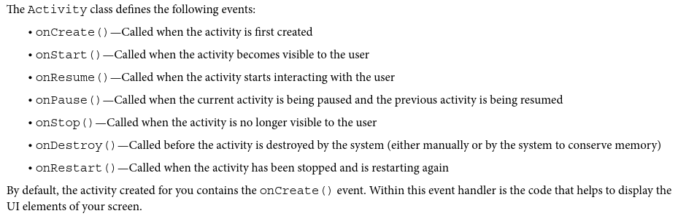
Activity Life Cycle
The activity base class defines a series of events that govern the life cycle of an activity.

Slide 4
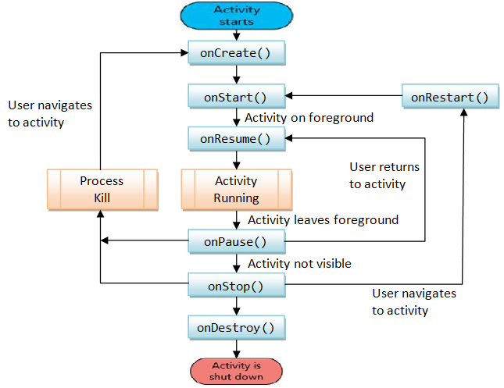
Activity Life Cycle

Slide 5
States of Activity Life cycle
Active State: [Activity in the Foreground/Running]
When an Activity is present at the top of the stack, it is the currently visible and focused Activity and all the user inputs are provided to it.
In order to keep this Activity active, Android provides it with all the required resources and also terminates the previous activities if required.
When another Activity becomes active, this Activity will be pushed to the paused state.

Slide 6
2. Paused State:
An Activity in this state is visible, but another Activity will have the focus and is present in the foreground.
An Activity in the paused state is treated in the same way as it was treated when it was in the active state.
The only difference is that it will not receive any user input.
In serious cases, Android terminates a paused Activity to ensure availability of resources to the current Activity.
An Activity is stopped when it becomes totally obscure.

Slide 7
3. Stopped State: [Activity in the background]
In this state, the Activity is not visible. It is however, present in the memory with all the state information.
All such activities are now ready for termination when the system requires memory.
When an Activity is stopped, it’s data and UI information needs to be saved.
An Activity becomes inactive when it is closed or exited.
4. Inactive State: [Activity Doesn’t exist]
When the Activity is no longer in the memory, it is said to be in the inactive state.
An Activity goes to the inactive state when it is terminated.
All such activities need to be restarted before they are used again.
Example : LifeCycleAcivityDemo Package from Lesson3

Slide 8
Hands on Example : Life Cycle Activity
Now we are going to Override all these methods to know the activity life cycle and always call up to superclass when implementing these methods. The we are displaying the Log message using Log.i(String TAG,String msg) by import android.util.Log;
public class MActivity extends Activity{
protected void onCreate(Bundle savedInstanceState);
protected void onStart();
protected void onRestart();
protected void onResume();
protected void onPause();
protected void onStop();
protected void onDestroy();
}
Refer: Lesson3_LogCat Filter Steps.pdf file to learn how to create logcat from Sakai Lectures/Lesson3 folder

Slide 9
MainActivity.java
import android.support.v7.app.AppCompatActivity; import android.os.Bundle; import android.util.Log; public class MainActivity extends AppCompatActivity { public static final String MY_TAG = "lifecycle"; @Override protected void onCreate(Bundle savedInstanceState) { super.onCreate(savedInstanceState); setContentView(R.layout.activity_main); Log.i(MY_TAG,"Method in OnCreate"); } @Override protected void onStart() { super.onStart(); Log.i(MY_TAG,"Method in OnStart"); } @Override protected void onResume() { super.onResume(); Log.i(MY_TAG,"Method in OnResume"); }
@Override protected void onPause() { super.onPause(); Log.i(MY_TAG,"Method in OnPause"); } @Override protected void onStop() { super.onStop(); Log.i(MY_TAG,"Method in OnStop"); } @Override protected void onRestart() { super.onRestart(); Log.i(MY_TAG,"Method in OnRestart"); } @Override protected void onDestroy() { super.onDestroy(); Log.i(MY_TAG,"Method in OnDestroy"); } }
Notes:
Difference between Activity and AppcompatActivity
By using Activity class in android you will not have to include any library, but then you will also not be able to target devices with API level less then 11.
AppCompatActivity is good if you’re targeting devices below API level 11 too, it provides fragments and some of the latest functionality and helps if you want to deploy your application before API level 11.

Slide 10
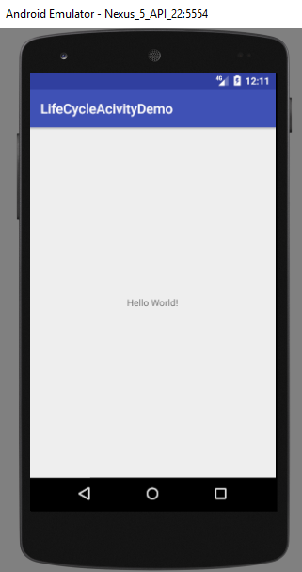

Activity Life Cycle – Screen Shots
Lifetime of an Activity is from onCreate() to onDestroy()
Activity is Visible when onStart() to onStop()
Activity is in Foreground onResume to onPause()
Screen 1 : After running the App, you will get the below screen and the Log message. The Activity is started by invoking 1. onCreate(), 2. onStart() and 3. onResume(). It is visible in the foreground.

Slide 11

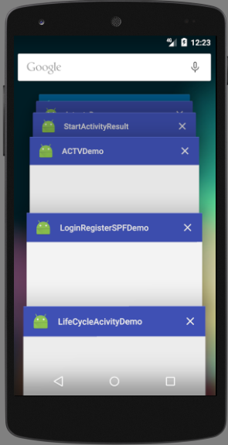

Activity Life Cycle – Screen Shots
Screen 2 : Now press the highlighted Pass button from your Emulator. The Activity is paused by invoking 1. OnPause() and 2. onStop(). Now it is not visible and not destroyed.

Slide 12
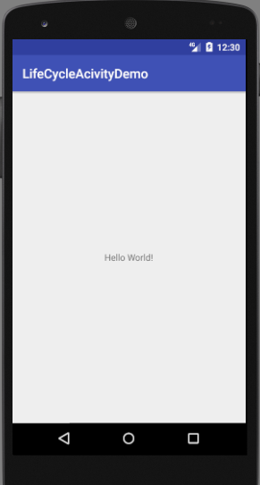

Activity Life Cycle – Screen Shots
Screen 3 : Again start your application by clicking highlighted start
button the from your Emulator and reload the same app. Now the Activity is restarted by invoking 1. OnRestart() 2. onStart() and 3. OnResume() itself. Now it is visible and not destroyed.

Slide 13
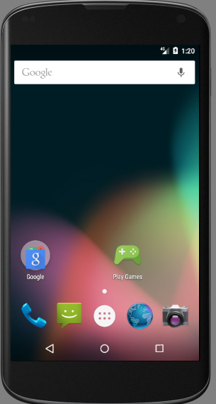

Activity Life Cycle – Screen Shots
Screen 4 : If you press the highlighted back button from your Emulator your activity is destroyed by invoking 1. onPause() 2. OnStop() and 3. onDestroy(). The lifetime of the activity becomes over.

Slide 14
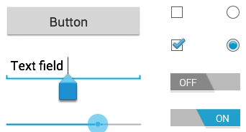
Basic UI Controls
Input controls are the interactive components in your app's user interface.
Android provides a wide variety of controls you can use in your UI, such as buttons, text fields, seek bars, checkboxes, zoom buttons, toggle buttons, and many more.
Each input control supports a specific set of input events so you can handle events such as when the user enters text or touches a button.
Adding an input control to your UI is as simple as importing the control class into your .java file and creating an object from the class.
For instance, to create a Button in code you would type:
Button myButton = new Button(this);
Then you can simply press Ctrl-Shift-o to import the Button class.
import android.widget.Button;
Refer : https://developer.android.com/guide/topics/ui/index.html

Slide 15
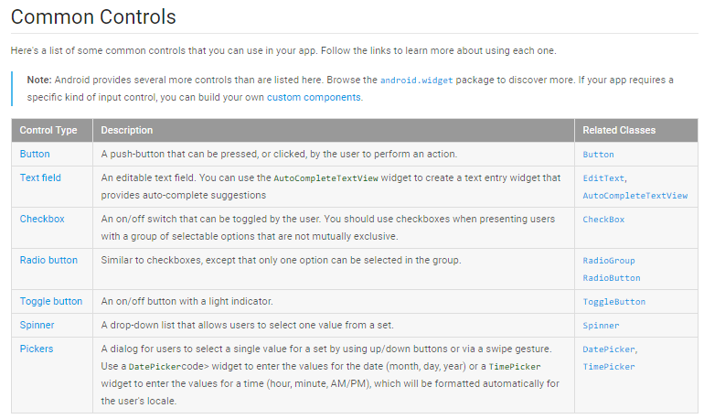

Slide 16

A button consists of text or an icon that communicates what action occurs when the user touches it.
Responding to Click Events
When the user clicks a button, the Button object receives an on-click event.
To set a click event handler for a button you can use the button's setOnClickListener(nameOfListener) function like this:
// Set the button OnClickListener
myButton.setOnClickListener(myListener);
then you can create a class member OnCLickListener object like this:
// Create an onClickListener Object
private View.OnClickListener myListener = new View.OnClickListener() { public void onClick(View v) { // Do something here } };

Slide 17
Using Built-in Layout Classes
The types of layouts built into the Android SDK framework include:
LinearLayout
RelativeLayout
TableLayout
FrameLayout
GridLayout
In our course we are going to discuss the first three layouts.
These layouts are derived from:
android.view.ViewGroup

Slide 18
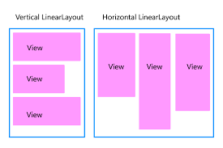
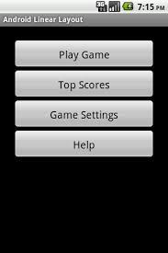
Linear Layout
A LinearLayout view organizes its child View controls in a single row, or a single column, depending on whether its orientation attribute is set to horizontal or vertical.
This is a very handy layout method for creating forms.

Slide 19
Linear Layout Example
<LinearLayout xmlns:android=
"http://schemas.android.com/apk/res/android"
android:layout_width="match_parent"
android:layout_height="match_parent“
android:orientation=“vertical”>
<TextView
android:id="@+id/TextView01"
android:layout_height="match_parent"
android:layout_width="match_parent" />
<Button
android:id="@+id/Button01"
android:layout_width="wrap_content"
android:layout_height="wrap_content“
android:text="Press Me"
android:layout_marginRight="20dp"
android:layout_marginTop="60dp" />
</LinearLayout>
Notes:
Here’s an XML layout resource example of a LinearLayout set to the size of the screen, containing one TextView that is set to its full height and the width of the LinearLayout (and therefore the screen).
android:id="@+id/Button01"
If you want to access the component from xml to java code, you have to configure the id for the component using the above line of code

Slide 20

Relative Layout
The RelativeLayout view enables you to specify where the child View controls are in relation to each other.
For instance, you can set a child View to be positioned “above” or “below” or “to the left of” or “to the right of” another View.
You can also align child View controls relative to one another or the parent layout edges.
Combining RelativeLayout attributes can simplify the creation of interesting user interfaces without resorting to multiple layout groups to achieve a desired effect.

Slide 21
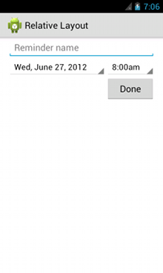
RelativeLayout
<?xml version="1.0" encoding="utf-8"?>
<RelativeLayout xmlns:android="http://schemas.android.com/apk/res/android"
android:layout_width="match_parent"
android:layout_height="match_parent"
android:paddingLeft="16dp"
android:paddingRight="16dp" >
<EditText
android:id="@+id/name"
android:layout_width="match_parent"
android:layout_height="wrap_content"
android:hint="@string/reminder" />
<Spinner
android:id="@+id/dates"
android:layout_width="0dp"
android:layout_height="wrap_content"
android:layout_below="@id/name"
android:layout_alignParentLeft="true"
android:layout_toLeftOf="@+id/times" />
<Spinner
android:id="@id/times"
android:layout_width="96dp"
android:layout_height="wrap_content"
android:layout_below="@id/name"
android:layout_alignParentRight="true" />
<Button
android:layout_width="96dp"
android:layout_height="wrap_content"
android:layout_below="@id/times"
android:layout_alignParentRight="true"
android:text="@string/done" />
</RelativeLayout>

Slide 22

Other Layout
Look them up on Android Developer site
They include: TableLayout (think a table), GridLayout, FrameLayout, and MORE!!
TableLayout

Slide 23
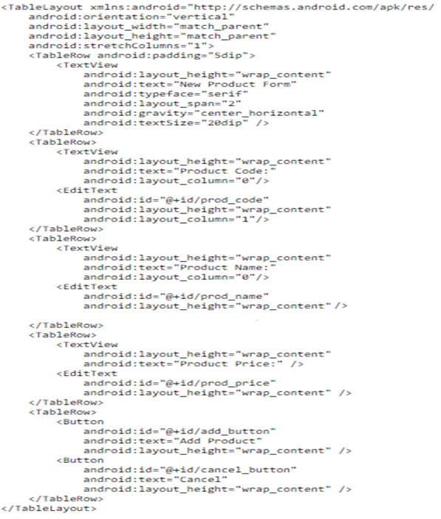
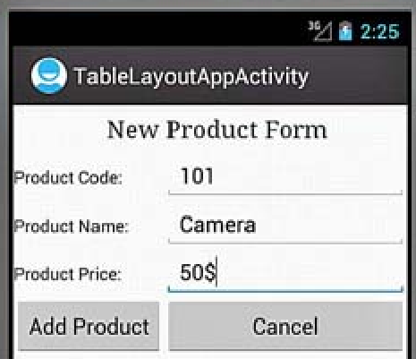
Table Layout Example
Notes:
Stretching Columns
The default width of a column is set equal to the width of the widest column, but we can stretch the column(s) to take up available free space using the android:stretchColumns attribute in the TableLayout. The value assigned to this attribute can be a single column number or a comma-delimited list of column numbers. The specified columns are stretched to take up any available space on the row.
android:stretchColumns="1"—The second column (because the column numbers are 0-based) is stretched to take up any available space in the row.
android:stretchColumns="0,1"—Both the first and second columns are stretched to take up the available space in the row.
android:stretchColumns="*"—All columns are stretched to take up the available space.
Spanning Columns
We can make a column span or take up the space of one or more columns by using the android:layout_span attribute. The value assigned to this attribute must be >=1. For example, the following value makes the control take or span up to two columns:
android:layout_span="2"

Slide 24
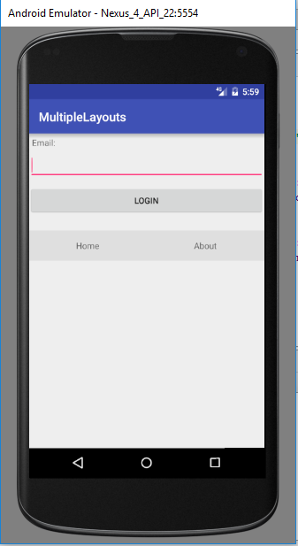
Nested Layouts
Combining different layout methods on a single screen can create complex layouts.
Remember that because a layout contains View controls and is, itself, a View control, it can contain other layouts.
Refer Demo Code\Lesson3\MultipleLayouts

Slide 25
<?xml version="1.0" encoding="utf-8"?> <!-- Parent linear layout with vertical orientation --> <LinearLayout xmlns:android="http://schemas.android.com/apk/res/android" android:orientation="vertical" android:layout_width="match_parent" android:layout_height="match_parent"> <TextView android:layout_width="match_parent" android:layout_height="wrap_content" android:text="Email:" android:padding="5dip"/> <EditText android:layout_width="match_parent" android:layout_height="wrap_content" android:layout_marginBottom="10dip"/> <Button android:layout_width="match_parent" android:layout_height="wrap_content" android:text="Login"/> <!-- Child linear layout with horizontal orientation --> <LinearLayout android:layout_width="match_parent" android:layout_height="wrap_content" android:orientation="horizontal" android:background="#1111" android:layout_marginTop="25dip"> <TextView android:layout_width="match_parent" android:layout_height="wrap_content" android:text="Home" android:padding="15dip" android:layout_weight="1" android:gravity="center"/> <TextView android:layout_width="match_parent" android:layout_height="wrap_content" android:text="About" android:padding="15dip" android:layout_weight="1" android:gravity="center"/> </LinearLayout> </LinearLayout>

Slide 26
Click Event
Handle the Click event in two ways
In XML
In Java Code
XML Way
Configure the following attribute to the UI component
android:onClick=“method name”
android:id="@+id/idname"
If you click the button, it will invoke the specified method from java code. You have to specify your action in java code by creating
public void methodname(View v) { //Implementation}
If the method is not available it will throw MethodNotFoundException
View is the parent class for all UI Group and components, by using this object you can call objects from xml.

Slide 27
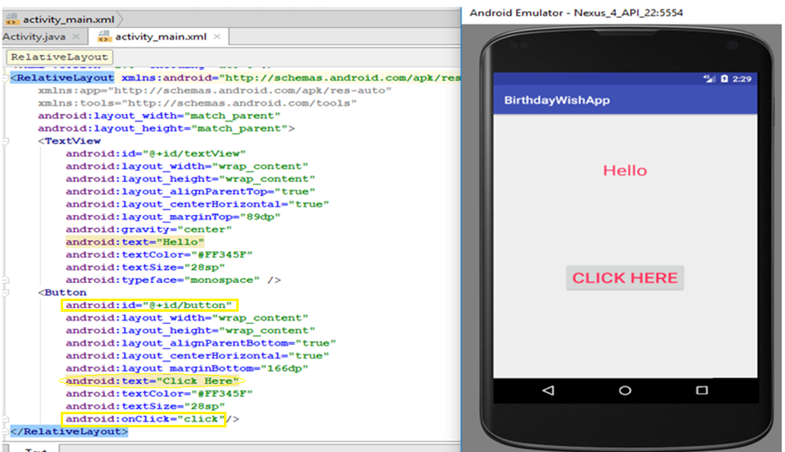
Hands on Example 1 – Birthday Wish – xml way
Problem Requirement : Click the Button to give a Birthday Wish by configuring click event in XML. Once you click the button Hello will be replaced as Happy Birthday
The Screen shot shows the activity_main.xml and Emulator screen

Slide 28
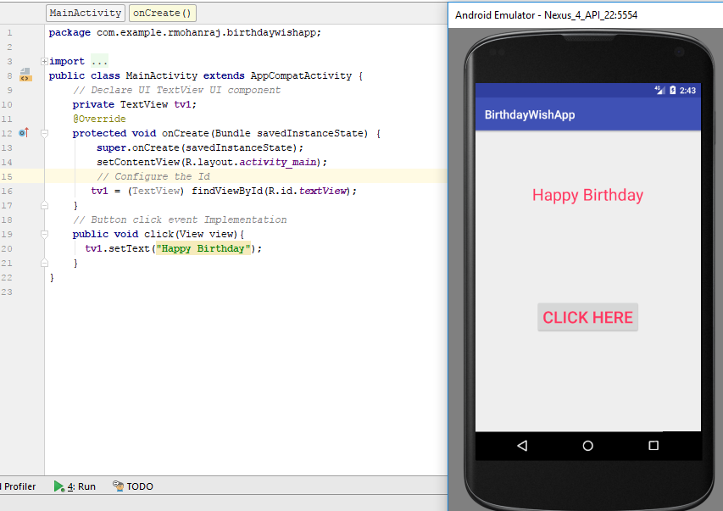
Hands on Example 1 – Birthday Wish
Result Screen: After clicking the CLICK HERE button, you will get the Happy Birthday Message.
The Screen shot shows the MainActivity.java and Emulator output screen
Notes:
Use the following method in Java, to get the UI Component from XML.
Syntax : findViewById(R.id.idname);
You have to declare the component in Java. For this example you have to get the TextView.
private TextView tv1;
tv1 = (TextView) findViewById(R.id.textView); // need to do explicit casting View object into TextView type

Slide 29
Click Event – In Java way
Java Way using Event Listeners
An event listener is an interface in the View class that contains a single callback method. These methods will be called by the Android framework when the View to which the listener has been registered is triggered by user interaction with the item in the UI.
onClick()From View.OnClickListener. This is called when the user either touches the item (when in touch mode), or focuses upon the item with the navigation-keys or trackball and presses the suitable "enter" key or presses down on the trackball.
Component. setOnClickListener(new View.OnClickListener() { @Override public void onClick(View v) {
// Your implementation
}
});

Slide 30
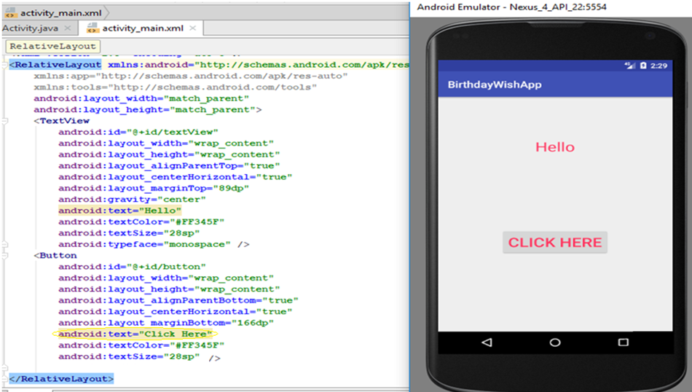
Hands on Example 1 – Birthday Wish using Listener
Remove the line android:onClick="click“ from activity_main.xml
The Screen shot shows the activity_main.xml and Emulator screen

Slide 31
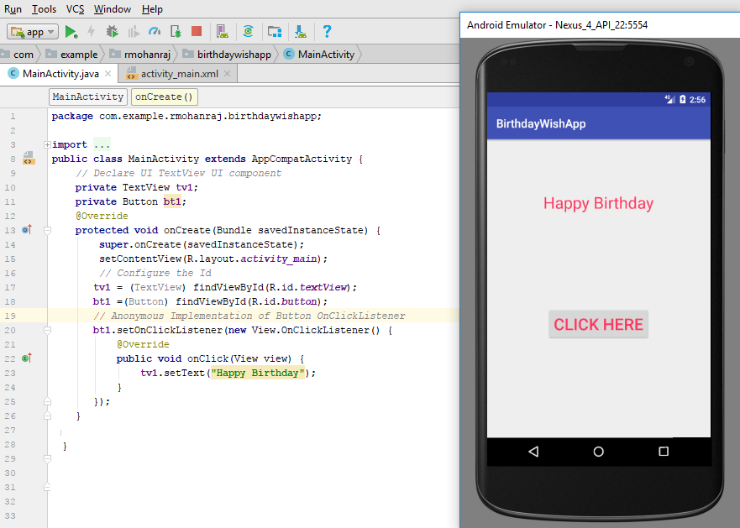
Hands on Example 1 – Birthday Wish using Listener
Result Screen: After clicking the CLICK HERE button, you will get the Happy Birthday Message. Refer Demo : Lesson3\BirthDayWishApp
The Screen shot shows the MainActivity.java and Emulator output screen

Slide 32
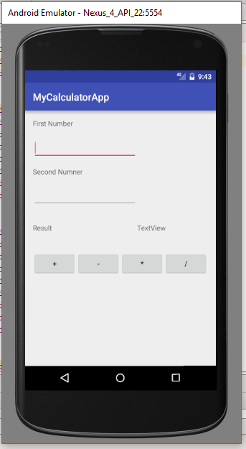
Hands on Example 2 – Simple Calculator
The requirement of this problem is to design a screen as per the screen shot, using nested layouts and performing click action on the operator buttons to display the Result. This screen uses 4 TextView, 2 EditText and 4 Buttons. The toper layout is Relative Layout and all buttons are combined using Linear Layout.
Refer Demo Code: Lesson3\MyCalculatorApp

Slide 33
XML Design(activity_main.xml
<TextView android:text="Second Numner" android:layout_width="wrap_content" android:layout_height="wrap_content" android:layout_marginTop="15dp" android:id="@+id/tv2" android:layout_below="@+id/et1" android:layout_alignLeft="@+id/et1" android:layout_alignStart="@+id/et1" /> <EditText android:layout_width="wrap_content" android:layout_height="wrap_content" android:inputType="number" android:ems="10" android:layout_marginTop="16dp" android:id="@+id/et2" android:layout_below="@+id/tv2" android:layout_alignParentLeft="true" android:layout_alignParentStart="true" /> <TextView android:text="Result" android:layout_width="wrap_content" android:layout_height="wrap_content" android:layout_marginTop="32dp" android:id="@+id/tv3" android:layout_below="@+id/et2" android:layout_alignParentLeft="true" android:layout_alignParentStart="true" /> <TextView android:text="TextView" android:layout_width="wrap_content" android:layout_height="wrap_content" android:id="@+id/tv4" android:layout_alignBaseline="@+id/tv3" android:layout_alignBottom="@+id/tv3" android:layout_toRightOf="@+id/et2" android:layout_toEndOf="@+id/et2" />
<RelativeLayout xmlns:android="http://schemas.android.com/apk/res/android" android:id="@+id/activity_main" android:layout_width="match_parent" android:layout_height="match_parent" android:paddingBottom="@dimen/activity_vertical_margin" android:paddingLeft="@dimen/activity_horizontal_margin" android:paddingRight="@dimen/activity_horizontal_margin" android:paddingTop="@dimen/activity_vertical_margin"> <TextView android:text="First Number" android:layout_width="wrap_content" android:layout_height="wrap_content" android:id="@+id/tv1" android:layout_alignLeft="@+id/et1" android:layout_alignStart="@+id/et1" android:layout_alignParentTop="true" /> <EditText android:layout_width="wrap_content" android:layout_height="wrap_content" android:inputType="number" android:ems="10" android:layout_marginTop="17dp" android:id="@+id/et1" android:layout_below="@+id/tv1" android:layout_alignLeft="@+id/et2" android:layout_alignStart="@+id/et2" />

Slide 34
<LinearLayout android:orientation="horizontal" android:layout_width="match_parent" android:layout_height="wrap_content" android:layout_marginTop="38dp" android:layout_below="@+id/tv3" android:layout_alignParentLeft="true" android:layout_alignParentStart="true"> <Button android:text="+“
android:layout_width="wrap_content" android:layout_height="wrap_content" android:id="@+id/add“
android:onClick="click"/> <Button android:text="-" android:layout_width="wrap_content" android:layout_height="wrap_content" android:id="@+id/sub"
android:onClick="click"/>
<Button
android:text="*" android:layout_width="wrap_content" android:layout_height="wrap_content" android:id="@+id/mul“
android:onClick="click"/>
<Button android:text="/" android:layout_width="wrap_content" android:layout_height="wrap_content“
android:id="@+id/div“
android:onClick="click"/>
</LinearLayout> </RelativeLayout>

Slide 35
Main Activity.java
import android.os.Bundle; import android.view.View; import android.widget.Button; import android.widget.EditText; import android.widget.TextView; import android.app.Activity; public class MainActivity extends Activity implements View.OnClickListener{ private Button b1,b2,b3,b4; private TextView tv; private EditText e1,e2; @Override protected void onCreate(Bundle savedInstanceState) { super.onCreate(savedInstanceState); setContentView(R.layout.activity_main); init(); }
private void init(){ b1 = (Button)findViewById(R.id.add); b2 = (Button)findViewById(R.id.sub); b3 = (Button)findViewById(R.id.mul); b4 = (Button)findViewById(R.id.div); tv = (TextView)findViewById(R.id.tv4); e1 = (EditText) findViewById(R.id.et1); e2 = (EditText) findViewById(R.id.et2); b1.setOnClickListener(this); b2.setOnClickListener(this); b3.setOnClickListener(this); b4.setOnClickListener(this); }

Slide 36
// Implement using Listener in . java file
@Override public void onClick(View view) { String num1 = e1.getText().toString(); String num2 = e1.getText().toString(); switch(view.getId()){ case R.id.add : int addition = Integer.parseInt(num1) + Integer.parseInt(num2); tv.setText(String.valueOf(addition)); break; case R.id.sub : int minus = Integer.parseInt(num1) - Integer.parseInt(num2); tv.setText(String.valueOf(minus)); break; case R.id.mul : int mult = Integer.parseInt(num1) * Integer.parseInt(num2); tv.setText(String.valueOf(mult)); break; case R.id.div: try { int dvd = Integer.parseInt(num1) / Integer.parseInt(num2); tv.setText(String.valueOf(dvd)); } catch(Exception e){ tv.setText("Division be Zero"); } break; } } }

